Slide 2

Project:
Monitoring land cover change of a Vietnamese city using satellite-based images
Student: Nguyễn Thanh Tùng

Slide 3
Project Requirements:
Read and understand information of satellite images (Ex: Landsat)
Exploit useful information from multiple spectral bands, not just RGB through spectral transformation
Apply a basic and simple classification algorithm (like threshold) to see land cover change of a city/area through decades
Apply a Machine Learning method to classify land cover types of the same selected area in multiple years

Slide 4
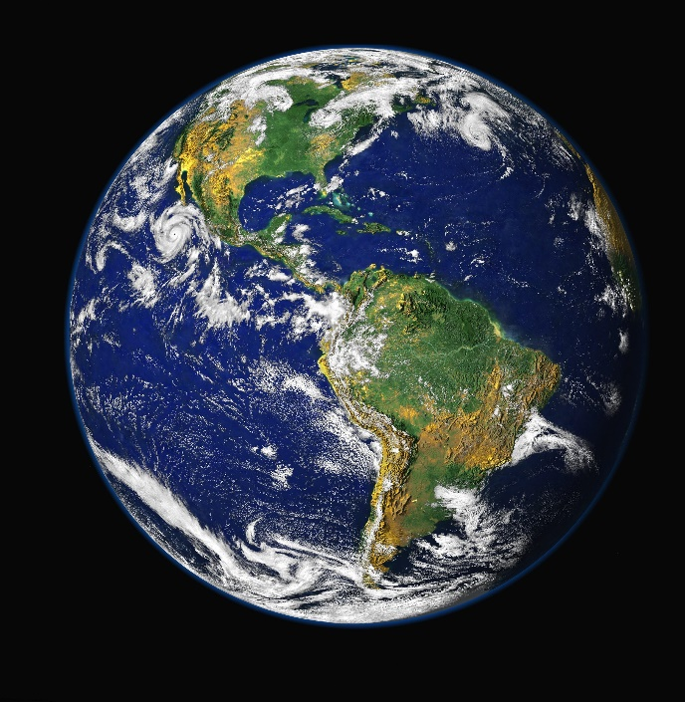
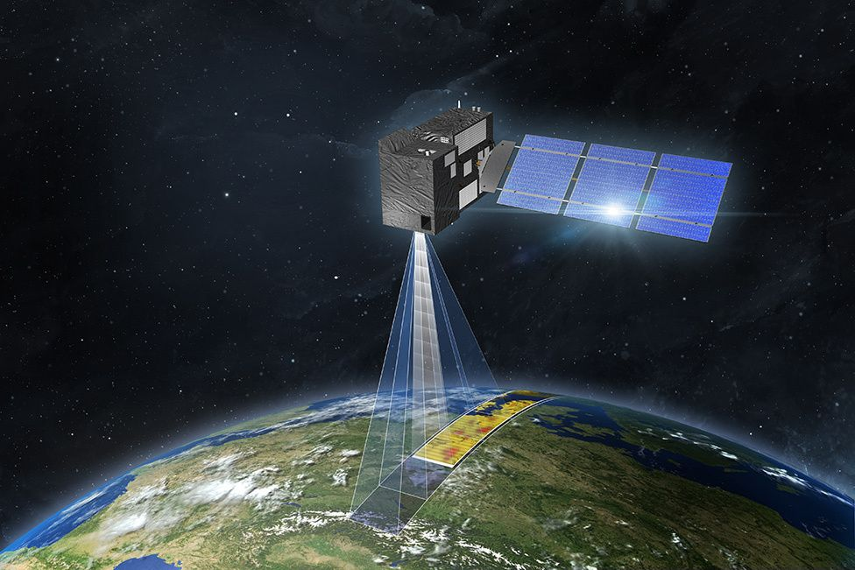
Satellite imagery:
Satellite images (also Earth observation imagery, spaceborne photography, or simply satellite photo) are images of Earth collected by imaging satellites operated by governments and businesses around the world.
Public Domain:
Lansat
Sentinel
MODIS
ASTER
Meteosat

Slide 5
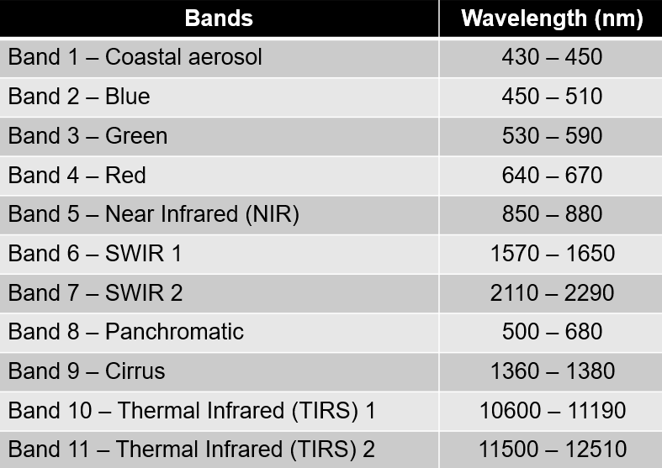
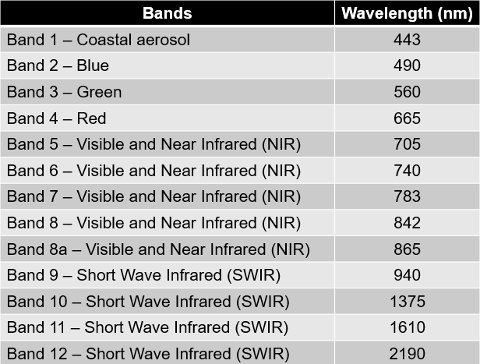
Multispectral images:
Landsat 8
Sentinel 2

Slide 6
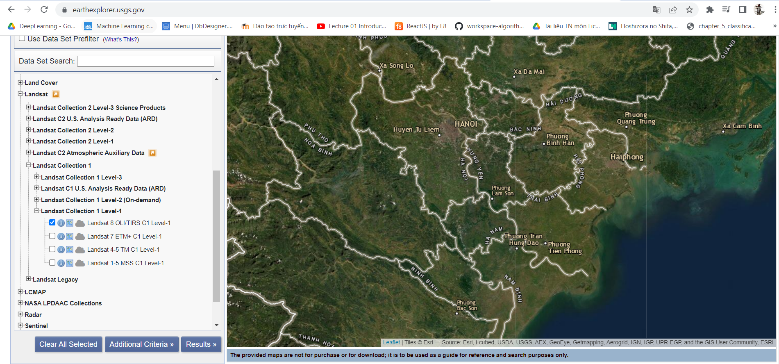
Data set:
Landsat 8 OLI/TIRS

Slide 7
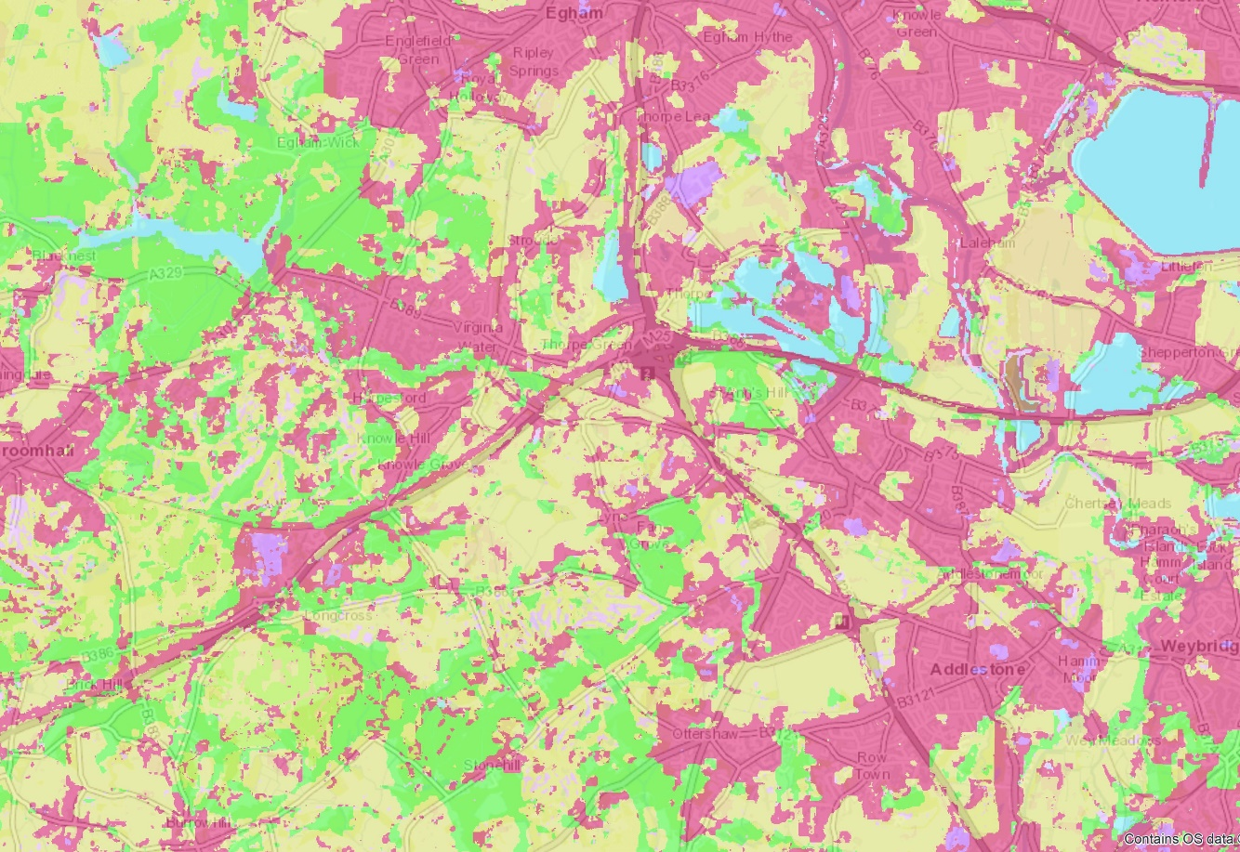
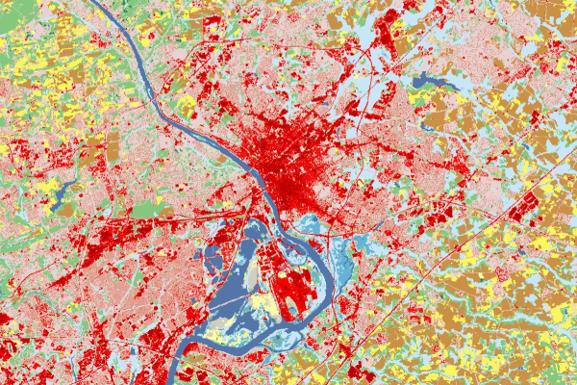
Monitoring land cover change:

Slide 8
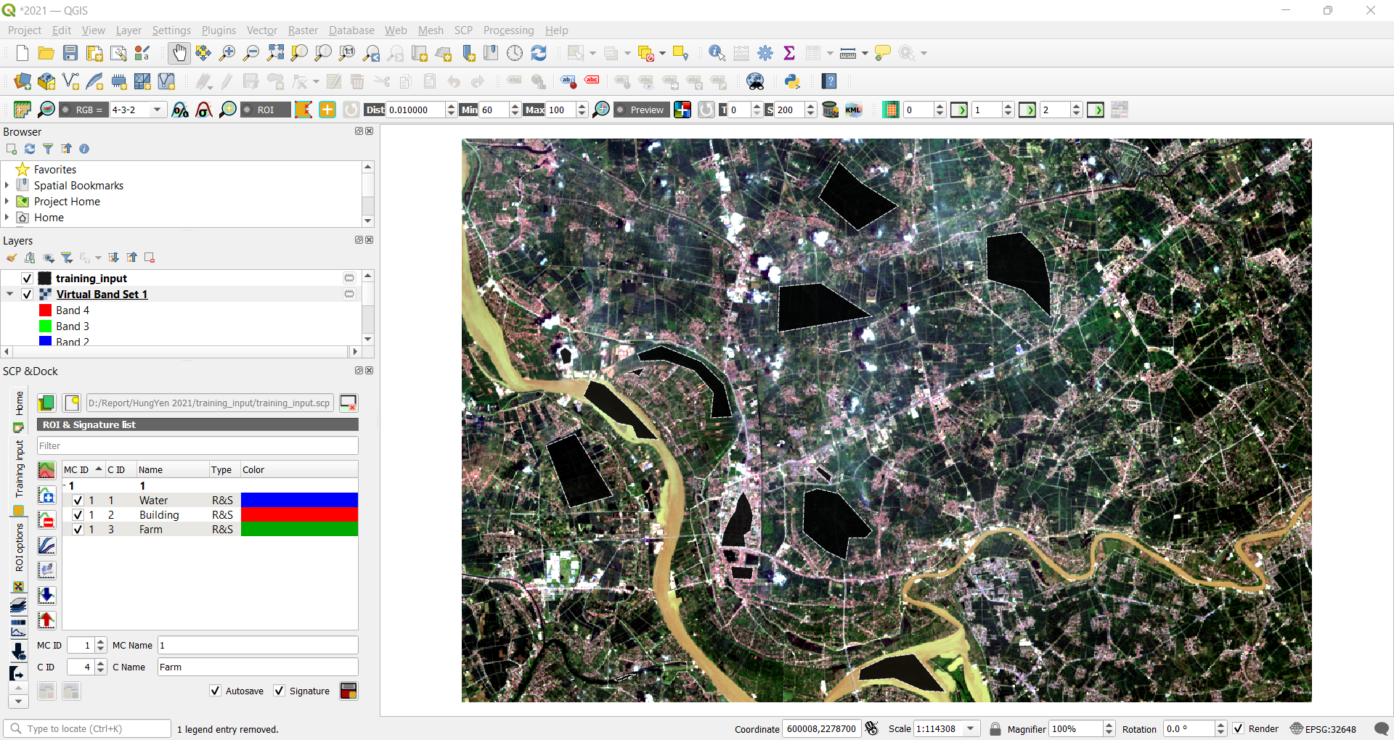
Land Cover Classification using the Semi-Automatic Classification Plugin

Slide 9
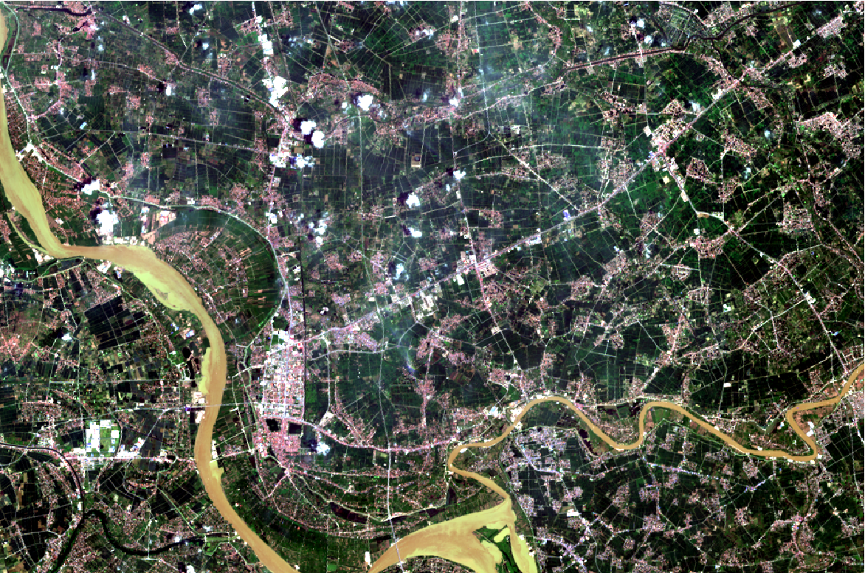
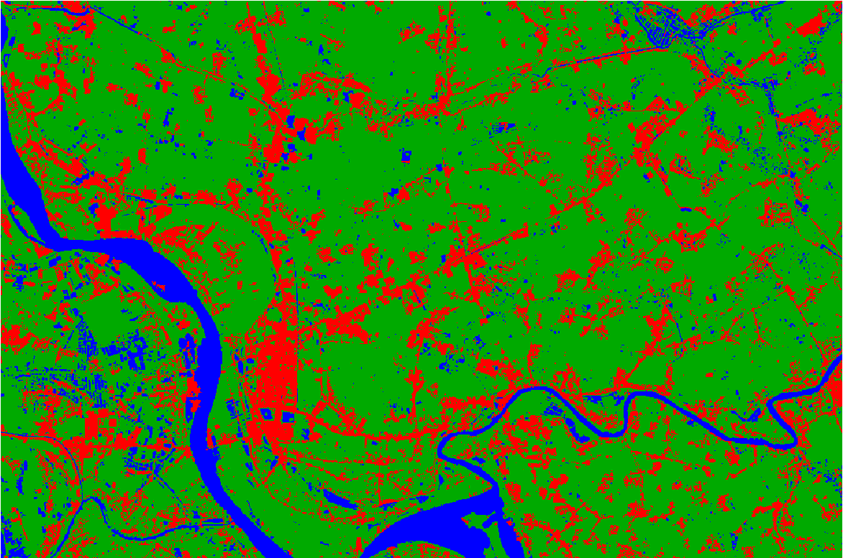
Land Cover Classification using the Semi-Automatic Classification Plugin
Hung Yen city ’s Satellite Image in 8/2021
(RGB)
Hung Yen city ’s Satellite Image in 8/2021
(After land cover classification)

Slide 10
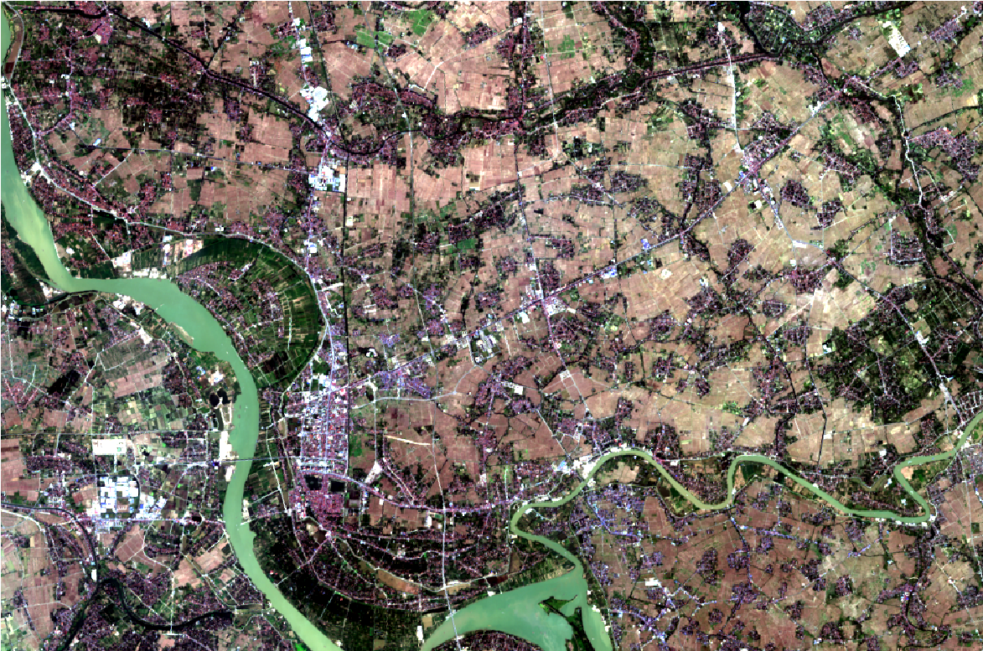
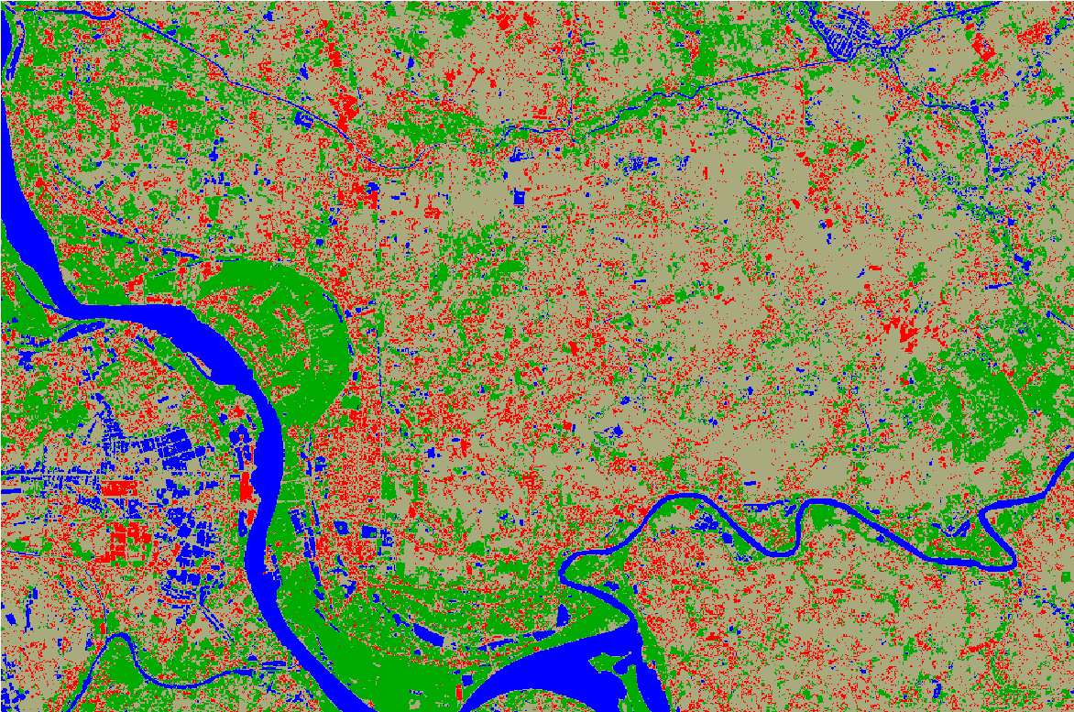
Land Cover Classification using the Semi-Automatic Classification Plugin
Hung Yen city ’s Satellite Image in 1/2022
(RGB)
Hung Yen city ’s Satellite Image in 1/2022
(After land cover classification)

Slide 11
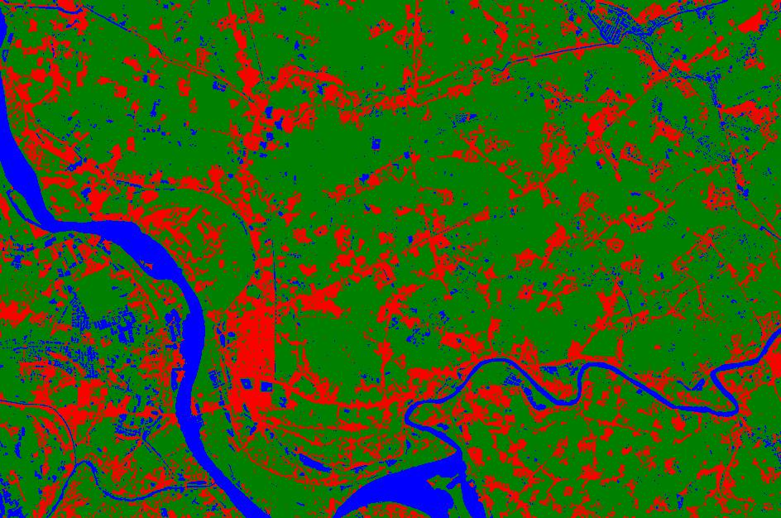
Apply K-Means Clustering to classify land cover
Hung Yen city ’s Satellite Image in 8/2021
(RGB)
Hung Yen city ’s Satellite Image in 8/2021
(After land cover classification with K-Means)

Slide 12
Apply K-Means Clustering to classify land cover
Hung Yen city ’s Satellite Image in 8/2021
(Semi-automatic classification plugin)
Hung Yen city ’s Satellite Image in 8/2021
(K-Means Clustering)

Slide 13
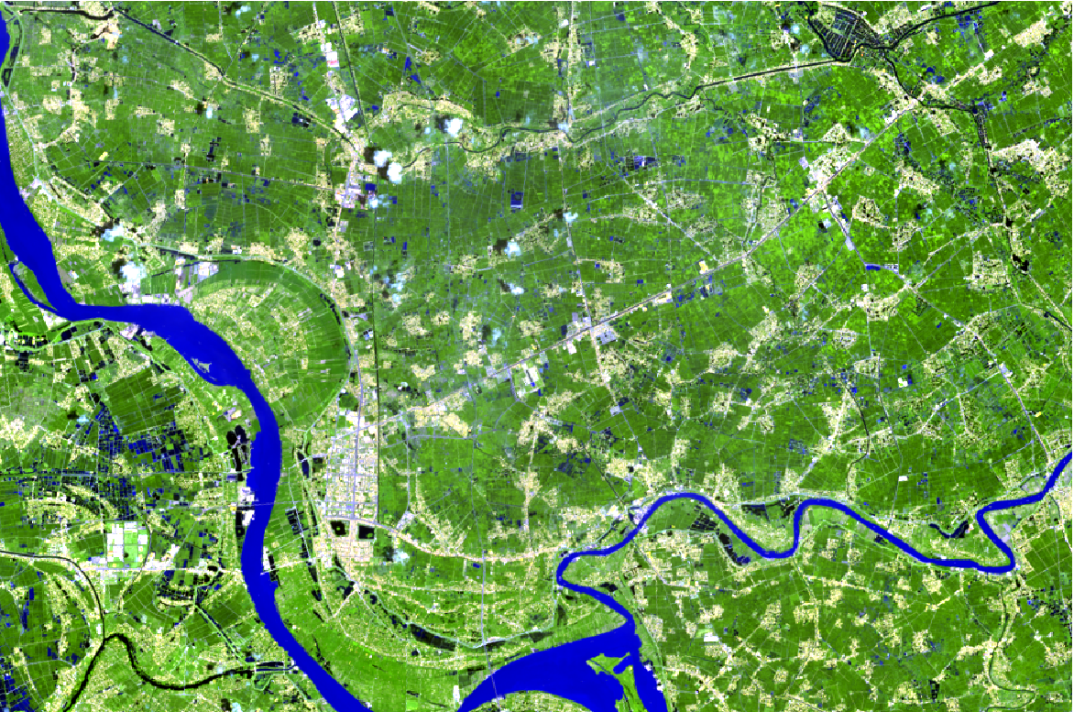
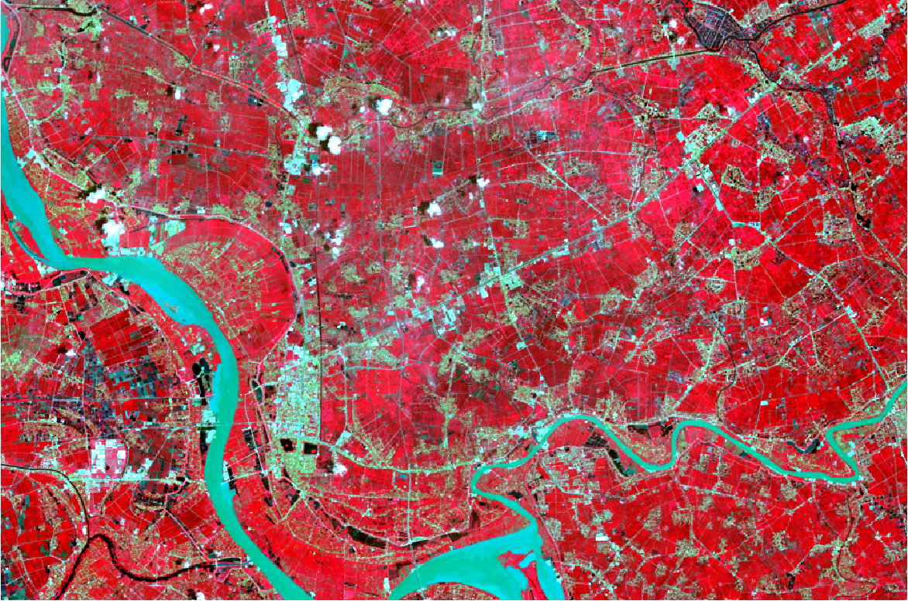
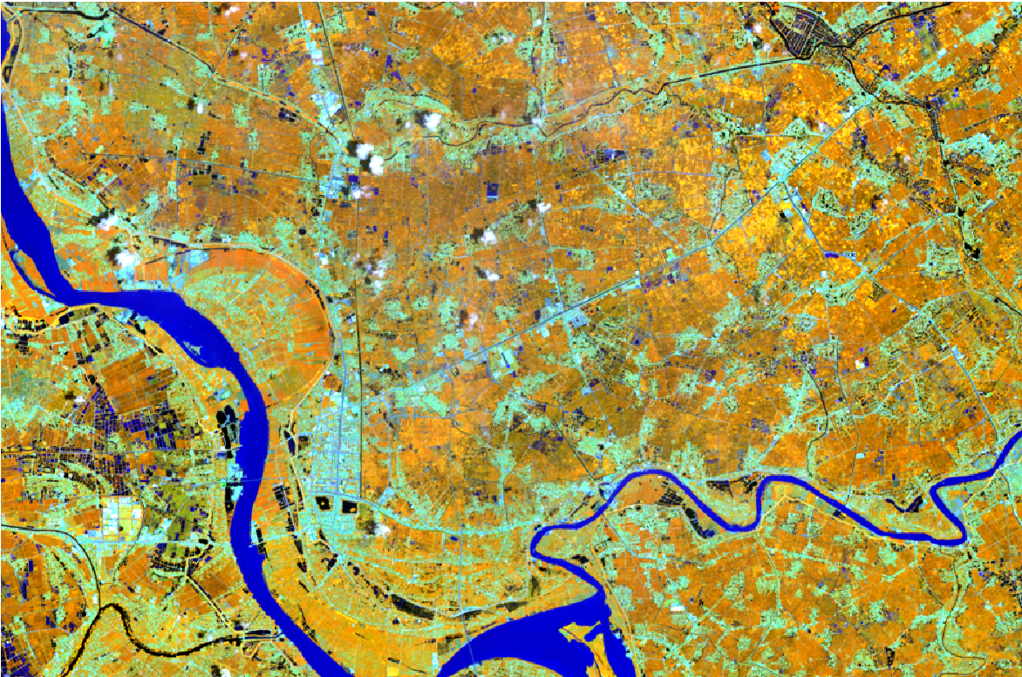
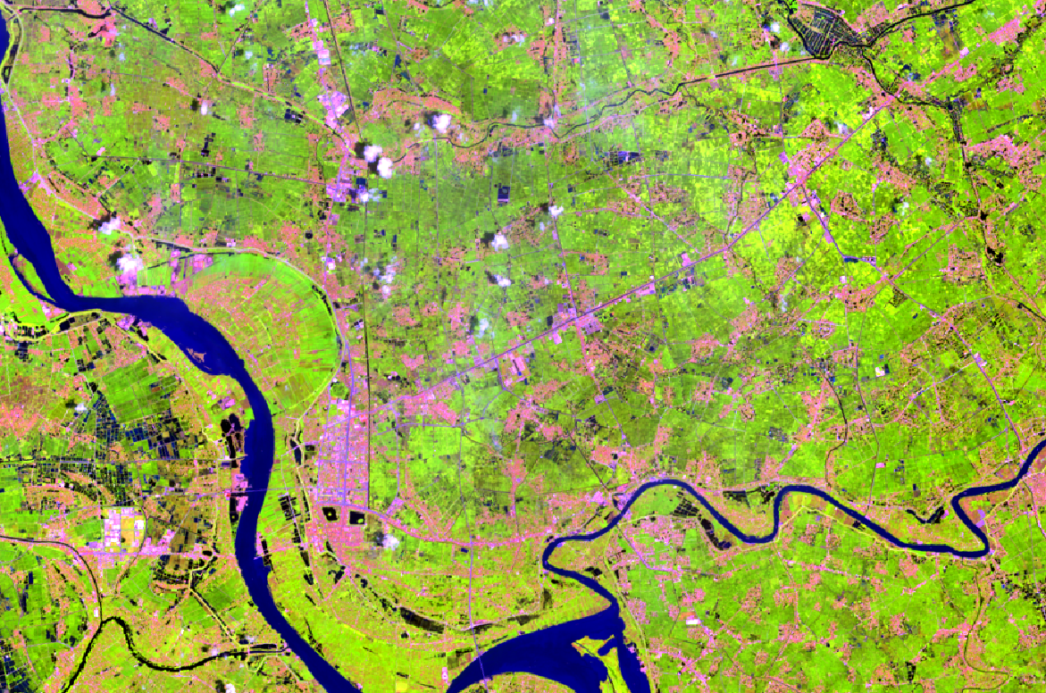
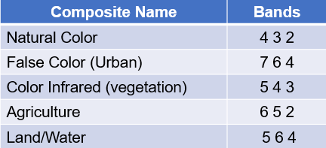
Band Combinations of Landsat 8

Slide 14
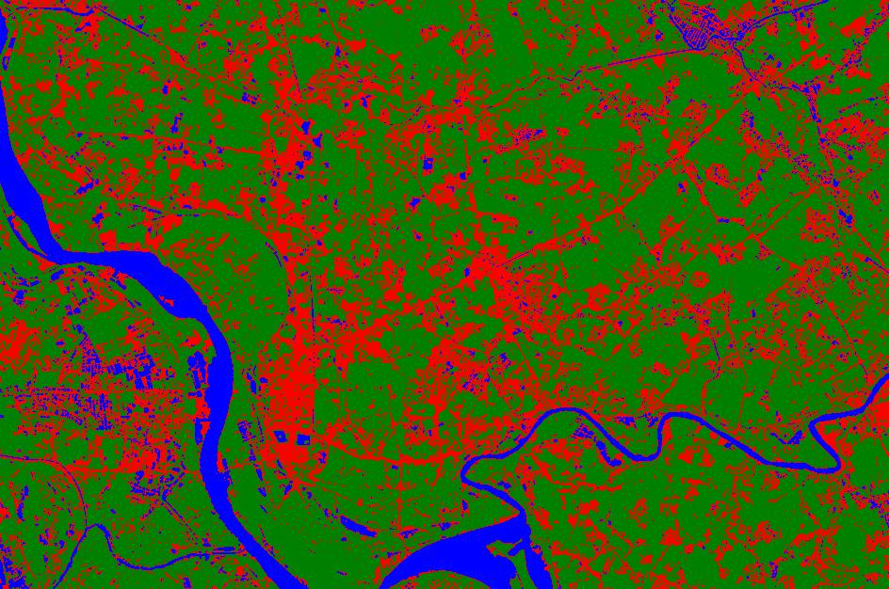
K-Means + Band Combinations
K-Means + Band Combinations
K-Means

Slide 15
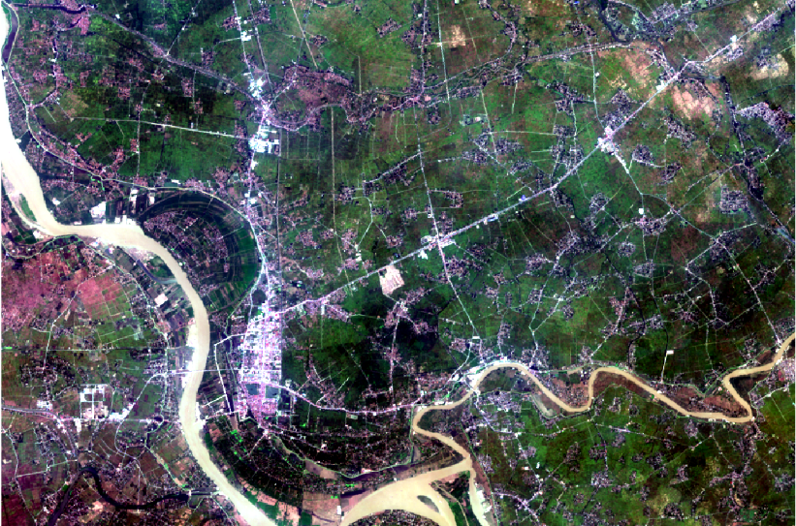
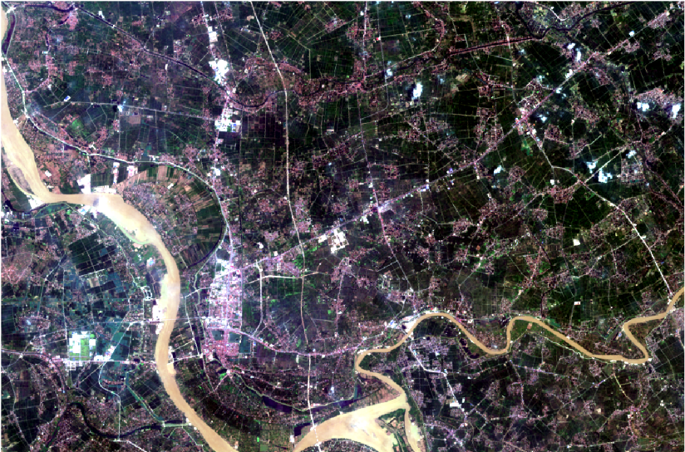

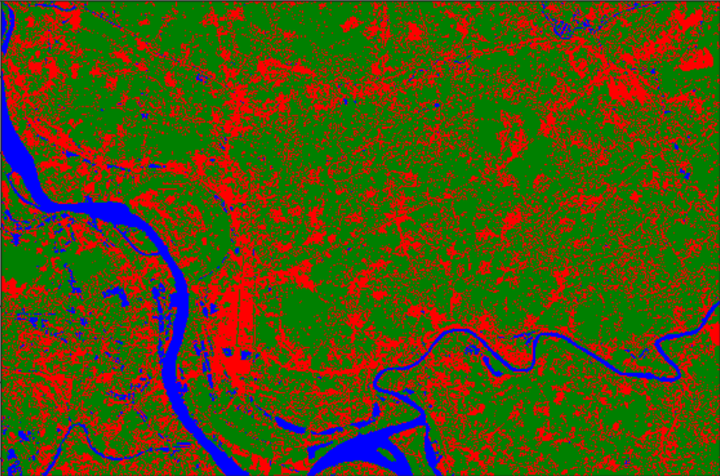
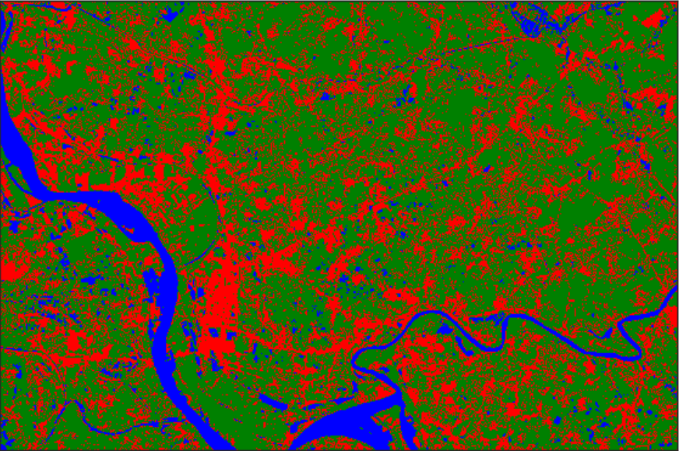
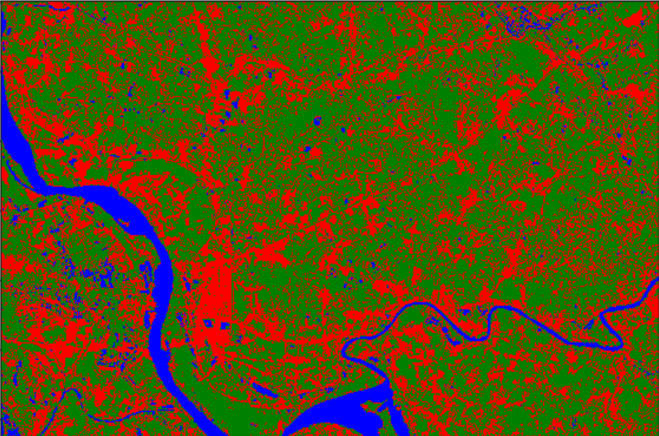
Monitoring land cover change of Hung Yen city
2013
2017
2021

Slide 16
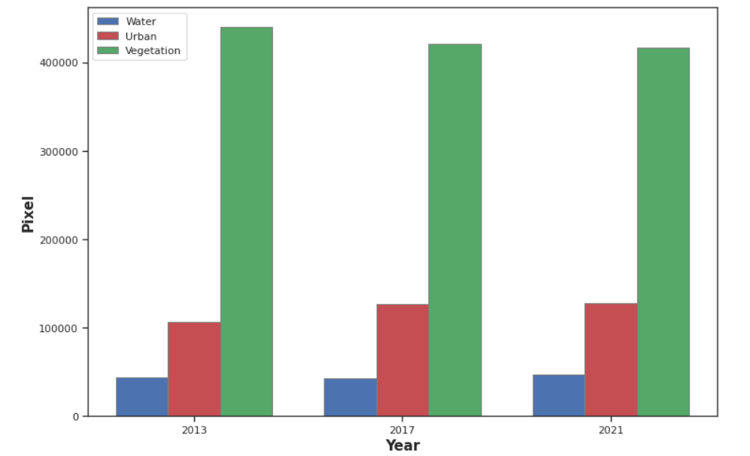
Monitoring land cover change of Hung Yen city

Slide 17
THANK YOU

